Slide 1
Fibonacci Heaps

Slide 2
Priority Queues Performance Cost Summary
Theorem. Starting from empty Fibonacci heap, any sequence of
a₁ insert, a₂ delete-min, and a₃ decrease-key operations takes
O(a₁ + a₂ log n + a₃) time.
Operation
Linked
List
Binary
Heap
Binomial
Heap
Fibonacci
Heap †
Relaxed
Heap
make-heap
1
1
1
1
1
is-empty
1
1
1
1
1
insert
1
log n
log n
1
1
delete-min
n
log n
log n
log n
log n
decrease-key
n
log n
log n
1
1
delete
n
log n
log n
log n
log n
union
1
n
log n
1
1
find-min
n
1
log n
1
1
n = number of elements in priority queue
† amortized
Notes:
main improvement: decrease-key is now O(1)
we'll emphasize the first 5 ops

Slide 3
Priority Queues Performance Cost Summary
Hopeless challenge. O(1) insert, delete-min and decrease-key. Why?
Operation
Linked
List
Binary
Heap
Binomial
Heap
Fibonacci
Heap †
Relaxed
Heap
make-heap
1
1
1
1
1
is-empty
1
1
1
1
1
insert
1
log n
log n
1
1
delete-min
n
log n
log n
log n
log n
decrease-key
n
log n
log n
1
1
delete
n
log n
log n
log n
log n
union
1
n
log n
1
1
find-min
n
1
log n
1
1
n = number of elements in priority queue
† amortized
Notes:
Q. If O(1) insert and delete-min then O(n) sort.
can only access the keys through pairwise comparisons

Slide 4
Fibonacci Heaps
History. [Fredman and Tarjan, 1986]
  Ingenious data structure and analysis.
  Original motivation: improve Dijkstra's shortest path algorithm
  from O(E log V ) to O(E + V log V ).
Basic idea.
  Similar to binomial heaps, but less rigid structure.
  Binomial heap: eagerly consolidate trees after each insert.
  Fibonacci heap: lazily defer consolidation until next delete-min.
V insert, V delete-min, E decrease-key
Notes:
also led to faster algorithms for Prim's MST algorithm and weighted bipartite matching (assignment problem)
less rigid structure to support more efficient delete-min

Slide 5
Fibonacci Heaps: Structure
each parent larger than its children
Fibonacci heap.
  Set of heap-ordered trees.
  Maintain pointer to minimum element.
  Set of marked nodes.
roots
heap-ordered tree
17
24
23
7
3
30
26
46
18
52
41
Heap H
35
44
39
Notes:
set -> unordered

Slide 6
Fibonacci Heaps: Structure
Fibonacci heap.
  Set of heap-ordered trees.
  Maintain pointer to minimum element.
  Set of marked nodes.
find-min takes O(1) time
min
17
24
23
7
3
30
26
46
18
52
41
Heap H
35
44
39
Notes:
set -> unordered

Slide 7
Fibonacci Heaps: Structure
Fibonacci heap.
  Set of heap-ordered trees.
  Maintain pointer to minimum element.
  Set of marked nodes.
use to keep heaps flat (stay tuned)
min
17
24
23
7
3
30
26
46
18
52
41
Heap H
35
marked
44
39
Notes:
set -> unordered

Slide 8
Fibonacci Heaps: Notation
Notation.
  n = number of nodes in heap.
  rank(x) = number of children of node x.
  rank(H) = max rank of any node in heap H.
  trees(H) = number of trees in heap H.
  marks(H) = number of marked nodes in heap H.
trees(H) = 5
marks(H) = 3
n = 14
rank = 3
min
17
24
23
7
3
30
26
46
18
52
41
Heap H
35
marked
44
39
Notes:
recall: with binomial heap, at most one tree of rank 0, 1, 2, 3, 4, …
nodes only change mark in Decrease-Key Can basically ignore marks until then.
marks are used to ensure size of heap is exponential in rank

Slide 9
Fibonacci Heaps: Potential Function
Φ(H) = trees(H) + 2 ⋅ marks(H)
potential of heap H
trees(H) = 5
marks(H) = 3
Φ(H) = 5 + 2⋅3 = 11
min
17
24
23
7
3
30
26
46
18
52
41
Heap H
35
marked
44
39

Slide 10
Insert

Slide 11
Fibonacci Heaps: Insert
Insert.
  Create a new singleton tree.
  Add to root list; update min pointer (if necessary).
insert 21
21
min
17
24
23
7
3
30
26
46
18
52
41
Heap H
35
44
39

Slide 12
Fibonacci Heaps: Insert
Insert.
  Create a new singleton tree.
  Add to root list; update min pointer (if necessary).
insert 21
min
17
24
23
7
21
3
30
26
46
18
52
41
Heap H
35
44
39
Notes:
lazy insert - don't consolidate trees when inserting into Fibonacci heap. If k consecutive inserts, the k 1-node trees are created.

Slide 13
Fibonacci Heaps: Insert Analysis
Actual cost. O(1)
Change in potential. +1
Amortized cost. O(1)
Φ(H) = trees(H) + 2 ⋅ marks(H)
potential of heap H
min
17
24
23
7
21
3
30
26
46
18
52
41
Heap H
35
44
39

Slide 14
Delete Min
Notes:
extracting min is where the deferred work of consolidating the roots takes place

Slide 15
Linking Operation
Linking operation. Make larger root be a child of smaller root.
larger root
smaller root
still heap-ordered
15
3
3
56
24
18
52
41
15
18
52
41
77
39
44
56
24
39
44
tree T₁
tree T₂
77
tree T'

Slide 16
Fibonacci Heaps: Delete Min
Delete min.
  Delete min; meld its children into root list; update min.
  Consolidate trees so that no two roots have same rank.
min
7
24
23
17
3
30
26
46
18
52
41
35
39
44

Slide 17
Fibonacci Heaps: Delete Min
Delete min.
  Delete min; meld its children into root list; update min.
  Consolidate trees so that no two roots have same rank.
min
7
24
23
17
18
52
41
30
26
46
39
44
35

Slide 18
Fibonacci Heaps: Delete Min
Delete min.
  Delete min; meld its children into root list; update min.
  Consolidate trees so that no two roots have same rank.
min
current
7
24
23
17
18
52
41
30
26
46
39
44
35

Slide 19
Fibonacci Heaps: Delete Min
Delete min.
  Delete min; meld its children into root list; update min.
  Consolidate trees so that no two roots have same rank.
rank
0
1
2
3
min
current
7
24
23
17
18
52
41
30
26
46
39
44
35

Slide 20
Fibonacci Heaps: Delete Min
Delete min.
  Delete min; meld its children into root list; update min.
  Consolidate trees so that no two roots have same rank.
rank
0
1
2
3
min
current
7
24
23
17
18
52
41
30
26
46
39
44
35

Slide 21
Fibonacci Heaps: Delete Min
Delete min.
  Delete min; meld its children into root list; update min.
  Consolidate trees so that no two roots have same rank.
rank
0
1
2
3
min
7
24
23
17
18
52
41
30
26
46
current
39
44
35

Slide 22
Fibonacci Heaps: Delete Min
Delete min.
  Delete min; meld its children into root list; update min.
  Consolidate trees so that no two roots have same rank.
rank
0
1
2
3
min
7
24
23
17
18
52
41
30
26
46
current
39
44
35
link 23 into 17

Slide 23
Fibonacci Heaps: Delete Min
Delete min.
  Delete min; meld its children into root list; update min.
  Consolidate trees so that no two roots have same rank.
rank
0
1
2
3
min
7
24
17
18
52
41
30
26
46
current
23
39
44
35
link 17 into 7

Slide 24
Fibonacci Heaps: Delete Min
Delete min.
  Delete min; meld its children into root list; update min.
  Consolidate trees so that no two roots have same rank.
rank
0
1
2
3
current
min
24
7
18
52
41
26
46
17
30
39
44
35
23
link 24 into 7

Slide 25
Fibonacci Heaps: Delete Min
Delete min.
  Delete min; meld its children into root list; update min.
  Consolidate trees so that no two roots have same rank.
rank
0
1
2
3
current
min
7
18
52
41
24
17
30
39
44
26
46
23
35

Slide 26
Fibonacci Heaps: Delete Min
Delete min.
  Delete min; meld its children into root list; update min.
  Consolidate trees so that no two roots have same rank.
rank
0
1
2
3
current
min
7
18
52
41
24
17
30
39
44
26
46
23
35

Slide 27
Fibonacci Heaps: Delete Min
Delete min.
  Delete min; meld its children into root list; update min.
  Consolidate trees so that no two roots have same rank.
rank
0
1
2
3
current
min
7
18
52
41
24
17
30
39
44
26
46
23
35

Slide 28
Fibonacci Heaps: Delete Min
Delete min.
  Delete min; meld its children into root list; update min.
  Consolidate trees so that no two roots have same rank.
rank
0
1
2
3
current
min
7
18
52
41
24
17
30
39
44
26
46
23
link 41 into 18
35

Slide 29
Fibonacci Heaps: Delete Min
Delete min.
  Delete min; meld its children into root list; update min.
  Consolidate trees so that no two roots have same rank.
rank
0
1
2
3
current
min
7
52
18
24
17
30
41
39
26
46
23
44
35

Slide 30
Fibonacci Heaps: Delete Min
Delete min.
  Delete min; meld its children into root list; update min.
  Consolidate trees so that no two roots have same rank.
rank
0
1
2
3
current
min
7
52
18
24
17
30
41
39
26
46
23
44
35

Slide 31
Fibonacci Heaps: Delete Min
Delete min.
  Delete min; meld its children into root list; update min.
  Consolidate trees so that no two roots have same rank.
min
7
52
18
24
17
30
41
39
26
46
23
44
stop
35

Slide 32
Fibonacci Heaps: Delete Min Analysis
Delete min.
Actual cost. O(rank(H)) + O(trees(H))
  O(rank(H)) to meld min's children into root list.
  O(rank(H)) + O(trees(H)) to update min.
  O(rank(H)) + O(trees(H)) to consolidate trees.
Change in potential. O(rank(H)) - trees(H)
  trees(H' ) ≤ rank(H) + 1 since no two trees have same rank.
  ΔΦ(H) ≤ rank(H) + 1 - trees(H).
Amortized cost. O(rank(H))
Φ(H) = trees(H) + 2 ⋅ marks(H)
potential function
Notes:
O(rank(H)) work adding min's children since at most rank(H) children of min
O(rank(H) + trees(H)) work updating min since at most this many resulting root nodes
O(rank(H) + trees(H)) to consolidate trees since number of roots decreases by 1 after each merging, and there at most rank(H) + trees(H) roots at beginning
trees(H') <= rank(H) + 1 since at worst the roots have degrees 0, 1, 2, …, rank(H)
can scale units in potential function to dominate cost hidden in O(trees(H))
number of marked nodes marked(H) does not increase [Note: you unmark a root y when it is linked to another root, though this case does not arise in the example]

Slide 33
Fibonacci Heaps: Delete Min Analysis
Q. Is amortized cost of O(rank(H)) good?
A. Yes, if only insert and delete-min operations.
  In this case, all trees are binomial trees.
  This implies rank(H) ≤ lg n.
A. Yes, we'll implement decrease-key so that rank(H) = O(log n).
we only link trees of equal rank
B₀
B₁
B₂
B₃
Notes:
if no decrease-key, our data structure is a lazy version of a binomial queue
decrease key will not preserve property that all trees are binomial trees, but it will be close enough to bound maximum degree by O(log n)

Slide 34
Decrease Key

Slide 35
Fibonacci Heaps: Decrease Key
Intuition for deceasing the key of node x.
  If heap-order is not violated, just decrease the key of x.
  Otherwise, cut tree rooted at x and meld into root list.
  To keep trees flat: as soon as a node has its second child cut,
  cut it off and meld into root list (and unmark it).
min
7
18
38
marked node:
one child already cut
24
17
23
21
39
41
26
46
30
52
35
88
72
Notes:
If decreasing the key of node i makes it violate heap order property, we can cutout subtree rooted at i and meld it into heap.
To keep trees bushy, we limit the number of cuts among the children of any vertex to 2.
Use the mark of a node to designate whether or not it has had one child cut off

Slide 36
Fibonacci Heaps: Decrease Key
Case 1. [heap order not violated]
  Decrease key of x.
  Change heap min pointer (if necessary).
min
7
18
38
24
17
23
21
39
41
26
46
29
30
52
x
35
88
72
decrease-key of x from 46 to 29

Slide 37
Fibonacci Heaps: Decrease Key
Case 1. [heap order not violated]
  Decrease key of x.
  Change heap min pointer (if necessary).
min
7
18
38
24
17
23
21
39
41
26
29
30
52
x
35
88
72
decrease-key of x from 46 to 29

Slide 38
Fibonacci Heaps: Decrease Key
Case 2a. [heap order violated]
  Decrease key of x.
  Cut tree rooted at x, meld into root list, and unmark.
  If parent p of x is unmarked (hasn't yet lost a child), mark it;
  Otherwise, cut p, meld into root list, and unmark
  (and do so recursively for all ancestors that lose a second child).
min
7
18
38
24
17
23
21
39
41
p
26
29
30
52
15
x
35
88
72
decrease-key of x from 29 to 15

Slide 39
Fibonacci Heaps: Decrease Key
Case 2a. [heap order violated]
  Decrease key of x.
  Cut tree rooted at x, meld into root list, and unmark.
  If parent p of x is unmarked (hasn't yet lost a child), mark it;
  Otherwise, cut p, meld into root list, and unmark
  (and do so recursively for all ancestors that lose a second child).
min
7
18
38
24
17
23
21
39
41
p
26
15
30
52
x
35
88
72
decrease-key of x from 29 to 15

Slide 40
Fibonacci Heaps: Decrease Key
Case 2a. [heap order violated]
  Decrease key of x.
  Cut tree rooted at x, meld into root list, and unmark.
  If parent p of x is unmarked (hasn't yet lost a child), mark it;
  Otherwise, cut p, meld into root list, and unmark
  (and do so recursively for all ancestors that lose a second child).
x
min
15
7
18
38
72
24
17
23
21
39
41
p
26
30
52
35
88
decrease-key of x from 29 to 15

Slide 41
Fibonacci Heaps: Decrease Key
Case 2a. [heap order violated]
  Decrease key of x.
  Cut tree rooted at x, meld into root list, and unmark.
  If parent p of x is unmarked (hasn't yet lost a child), mark it;
  Otherwise, cut p, meld into root list, and unmark
  (and do so recursively for all ancestors that lose a second child).
x
min
15
7
18
38
72
24
24
17
23
21
39
41
mark parent
p
26
30
52
35
88
decrease-key of x from 29 to 15

Slide 42
Fibonacci Heaps: Decrease Key
Case 2b. [heap order violated]
  Decrease key of x.
  Cut tree rooted at x, meld into root list, and unmark.
  If parent p of x is unmarked (hasn't yet lost a child), mark it;
  Otherwise, cut p, meld into root list, and unmark
  (and do so recursively for all ancestors that lose a second child).
min
15
7
18
38
72
24
24
17
23
21
39
41
p
26
30
52
35
88
decrease-key of x from 35 to 5
x
5

Slide 43
Fibonacci Heaps: Decrease Key
Case 2b. [heap order violated]
  Decrease key of x.
  Cut tree rooted at x, meld into root list, and unmark.
  If parent p of x is unmarked (hasn't yet lost a child), mark it;
  Otherwise, cut p, meld into root list, and unmark
  (and do so recursively for all ancestors that lose a second child).
min
15
7
18
38
72
24
24
17
23
21
39
41
p
26
30
52
x
5
88
decrease-key of x from 35 to 5

Slide 44
Fibonacci Heaps: Decrease Key
Case 2b. [heap order violated]
  Decrease key of x.
  Cut tree rooted at x, meld into root list, and unmark.
  If parent p of x is unmarked (hasn't yet lost a child), mark it;
  Otherwise, cut p, meld into root list, and unmark
  (and do so recursively for all ancestors that lose a second child).
min
x
15
5
7
18
38
72
24
24
17
23
21
39
41
p
26
30
52
88
decrease-key of x from 35 to 5

Slide 45
Fibonacci Heaps: Decrease Key
Case 2b. [heap order violated]
  Decrease key of x.
  Cut tree rooted at x, meld into root list, and unmark.
  If parent p of x is unmarked (hasn't yet lost a child), mark it;
  Otherwise, cut p, meld into root list, and unmark
  (and do so recursively for all ancestors that lose a second child).
min
x
15
5
7
18
38
72
24
24
17
23
21
39
41
second child cut
p
26
30
52
88
decrease-key of x from 35 to 5

Slide 46
Fibonacci Heaps: Decrease Key
Case 2b. [heap order violated]
  Decrease key of x.
  Cut tree rooted at x, meld into root list, and unmark.
  If parent p of x is unmarked (hasn't yet lost a child), mark it;
  Otherwise, cut p, meld into root list, and unmark
  (and do so recursively for all ancestors that lose a second child).
min
x
p
15
5
26
7
18
38
88
24
72
24
17
23
21
39
41
30
52
decrease-key of x from 35 to 5

Slide 47
Fibonacci Heaps: Decrease Key
Case 2b. [heap order violated]
  Decrease key of x.
  Cut tree rooted at x, meld into root list, and unmark.
  If parent p of x is unmarked (hasn't yet lost a child), mark it;
  Otherwise, cut p, meld into root list, and unmark
  (and do so recursively for all ancestors that lose a second child).
min
x
p
15
5
26
7
18
38
88
24
72
p'
24
17
23
21
39
41
30
52
second child cut
decrease-key of x from 35 to 5

Slide 48
Fibonacci Heaps: Decrease Key
Case 2b. [heap order violated]
  Decrease key of x.
  Cut tree rooted at x, meld into root list, and unmark.
  If parent p of x is unmarked (hasn't yet lost a child), mark it;
  Otherwise, cut p, meld into root list, and unmark
  (and do so recursively for all ancestors that lose a second child).
min
x
p
p'
p''
15
5
26
24
7
18
38
72
88
don't mark
parent if
it's a root
17
23
21
39
41
30
52
decrease-key of x from 35 to 5
Notes:
Note: when a root is linked into another root (in delete-min consolidation phase), we unmark it
Q. How can a root node ever be marked?
A. In delete-min we delete a root node, but promote all of its (potentially) marked children to be roots.

Slide 49
Fibonacci Heaps: Decrease Key Analysis
Decrease-key.
Actual cost. O(c)
  O(1) time for changing the key.
  O(1) time for each of c cuts, plus melding into root list.
Change in potential. O(1) - c
  trees(H') = trees(H) + c.
  marks(H') ≤ marks(H) - c + 2.
  ΔΦ ≤ c + 2 ⋅ (-c + 2) = 4 - c.
Amortized cost. O(1)
Φ(H) = trees(H) + 2 ⋅ marks(H)
potential function
Notes:
When marked node y is cut by cascading cut, its mark bit is cleared (2 units of potential).
One unit pays for cut, the other for unit increase in potential due to y becoming a root.
marks(H') <= marks(H) - c + 2: each cut (except first) unmarks a node; last cut may or may not mark a node
Can scale units of potential to dominate cost hidden in O(c) term

Slide 50
Analysis

Slide 51
Analysis Summary
Insert. O(1)
Delete-min. O(rank(H)) †
Decrease-key. O(1) †
Key lemma. rank(H) = O(log n).
† amortized
number of nodes is exponential in rank

Slide 52
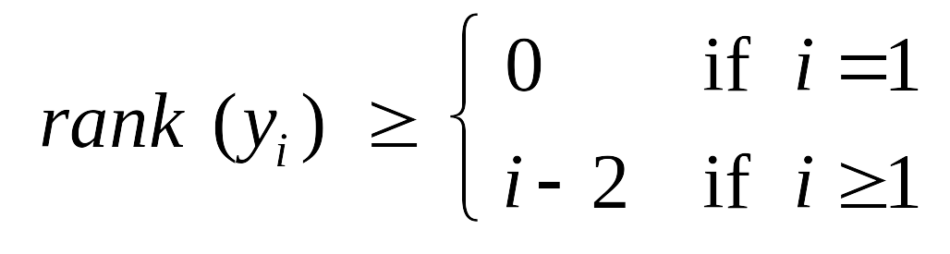
Fibonacci Heaps: Bounding the Rank
Lemma. Fix a point in time. Let x be a node, and let y₁, …, y_{k} denote
its children in the order in which they were linked to x. Then:
Pf.
  When y_{i} was linked into x, x had at least i -1 children y₁, …, y_{i-1}.
  Since only trees of equal rank are linked, at that time
  rank(y_{i}) = rank(x_{i}) ≥ i - 1.
  Since then, y_{i} has lost at most one child.
  Thus, right now rank(y_{i}) ≥ i - 2.
x
y₁
y₂
…
y_{k}
or y_{i} would have been cut
Notes:
when yi was linked into x, x could have had more than i-1 children since some of them may have since been cut

Slide 53
Fibonacci Heaps: Bounding the Rank
Lemma. Fix a point in time. Let x be a node, and let y₁, …, y_{k} denote
its children in the order in which they were linked to x. Then:
Def. Let F_{k} be smallest possible tree of rank k satisfying property.
x
y₁
y₂
…
y_{k}
F₀
F₁
F₂
F₃
F₄
F₅
1
2
3
5
8
13
Notes:
slightly non-standard definition of fibonacci with f0 = 1, f1 = 2

Slide 54
Fibonacci Heaps: Bounding the Rank
Lemma. Fix a point in time. Let x be a node, and let y₁, …, y_{k} denote
its children in the order in which they were linked to x. Then:
Def. Let F_{k} be smallest possible tree of rank k satisfying property.
x
y₁
y₂
…
y_{k}
F₄
F₅
F₆
8
13
8 + 13 = 21
Notes:
slightly non-standard definition of fibonacci with f0 = 1, f1 = 2

Slide 55
Fibonacci Heaps: Bounding the Rank
Lemma. Fix a point in time. Let x be a node, and let y₁, …, y_{k} denote
its children in the order in which they were linked to x. Then:
Def. Let F_{k} be smallest possible tree of rank k satisfying property.
Fibonacci fact. F_{k} ≥ φ^{k}, where φ = (1 + √5) / 2 ≈ 1.618.
Corollary. rank(H) ≤ log_{φ} n .
x
y₁
y₂
…
y_{k}
golden ratio

Slide 56
Fibonacci Numbers

Slide 57
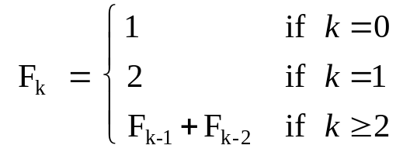
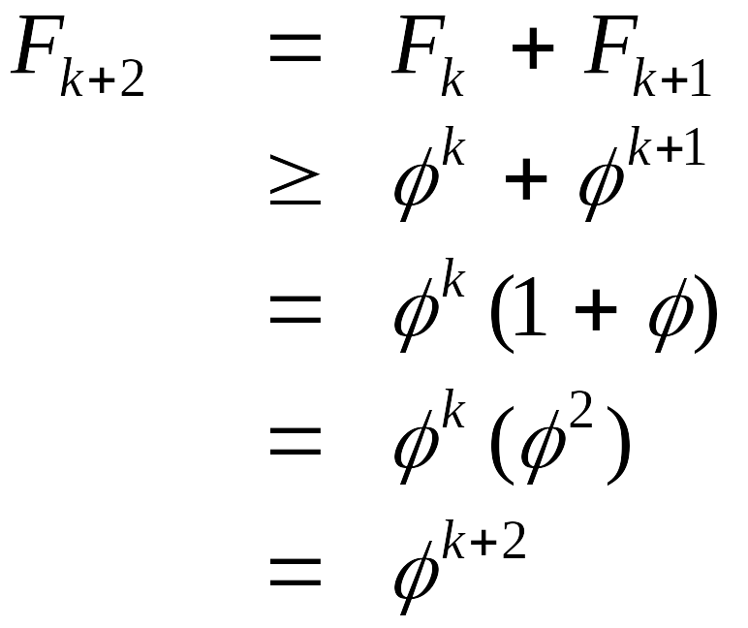
Fibonacci Numbers: Exponential Growth
Def. The Fibonacci sequence is: 1, 2, 3, 5, 8, 13, 21, …
Lemma. F_{k} ≥ φ^{k}, where φ = (1 + √5) / 2 ≈ 1.618.
Pf. [by induction on k]
  Base cases: F₀ = 1 ≥ 1, F₁ = 2 ≥ φ.
  Inductive hypotheses: F_{k} ≥ φ^{k} and F_{k+1} ≥ φ^{k + 1}
slightly non-standard definition
(definition)
(inductive hypothesis)
(algebra)
(φ² = φ + 1)
(algebra)

Slide 58
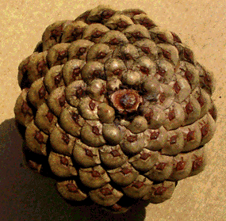
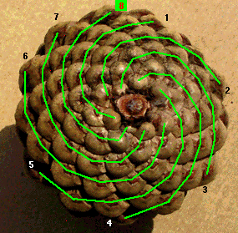
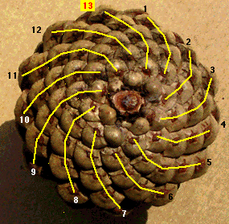
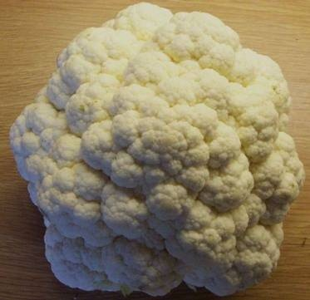
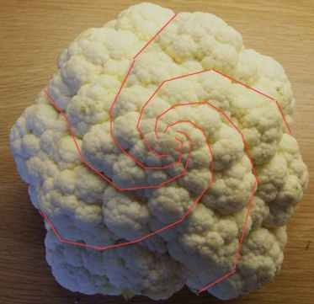
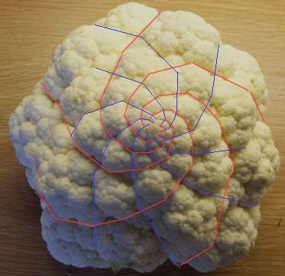
Fibonacci Numbers and Nature
pinecone
cauliflower
Notes:
http://www.mcs.surrey.ac.uk/Personal/R.Knott/Fibonacci/fibnat.html

Slide 59
Union

Slide 60
Fibonacci Heaps: Union
Union. Combine two Fibonacci heaps.
Representation. Root lists are circular, doubly linked lists.
min
min
23
24
17
7
3
21
30
26
46
18
52
41
Heap H'
35
Heap H''
44
39

Slide 61
Fibonacci Heaps: Union
Union. Combine two Fibonacci heaps.
Representation. Root lists are circular, doubly linked lists.
min
23
24
17
7
3
21
30
26
46
18
52
41
35
Heap H
44
39

Slide 62
Fibonacci Heaps: Union
Actual cost. O(1)
Change in potential. 0
Amortized cost. O(1)
Φ(H) = trees(H) + 2 ⋅ marks(H)
potential function
min
23
24
17
7
3
21
30
26
46
18
52
41
35
Heap H
44
39

Slide 63
Delete

Slide 64
Fibonacci Heaps: Delete
Delete node x.
  decrease-key of x to -∞.
  delete-min element in heap.
Amortized cost. O(rank(H))
  O(1) amortized for decrease-key.
  O(rank(H)) amortized for delete-min.
Φ(H) = trees(H) + 2 ⋅ marks(H)
potential function

Slide 65
Priority Queues Performance Cost Summary
Operation
Linked
List
Binary
Heap
Binomial
Heap
Fibonacci
Heap †
Relaxed
Heap
make-heap
1
1
1
1
1
is-empty
1
1
1
1
1
insert
1
log n
log n
1
1
delete-min
n
log n
log n
log n
log n
decrease-key
n
log n
log n
1
1
delete
n
log n
log n
log n
log n
union
1
n
log n
1
1
find-min
n
1
log n
1
1
n = number of elements in priority queue
† amortized
Notes:
main improvement: decrease-key is now O(1)
we'll emphasize the first 5 ops

